Slide 1
Accelerating Smart Play-Out
David Harel (WIS), Hillel Kugler (MSR),
Shahar Maoz (WIS) & Itai Segall (WIS)
SOFSEM 2010, Spindleruv Mlyn, The Czech Republic, Jan 2010

Slide 2
Outline
Introduction – Live Sequence Charts (LSCs)
Play-out & Smart play-out
Acceleration
Results

Slide 3
Live Sequence Charts (LSCs) (DH01)
Visual specification language
Scenario-based (extension of MSC)
Inter-object
Operational semantics
[ W. Damm and D. Harel. LSCs: Breathing Life into Message Sequence Charts. J. on Form.
Meth. in Sys. Design, 19(1):45-80, 2001]

Slide 4
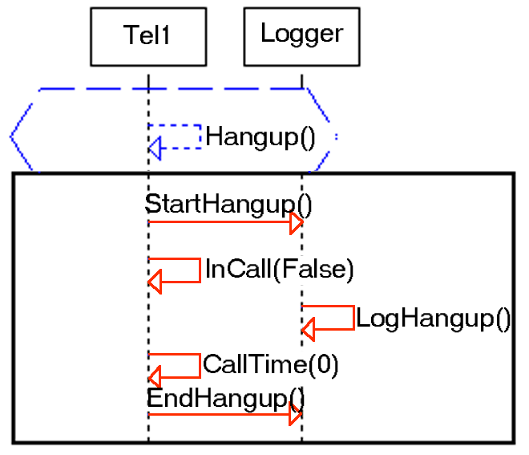
LSC Example
Prechart (if)
Main chart (then)
Red = hot (must)

Slide 5
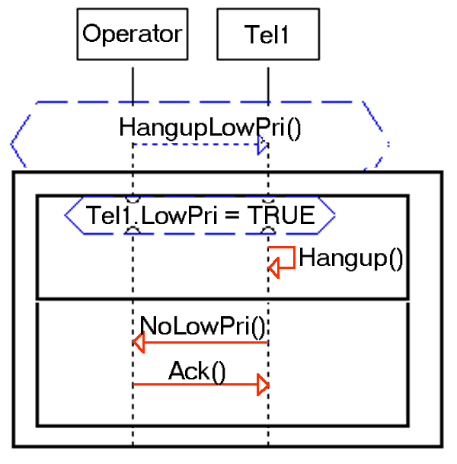
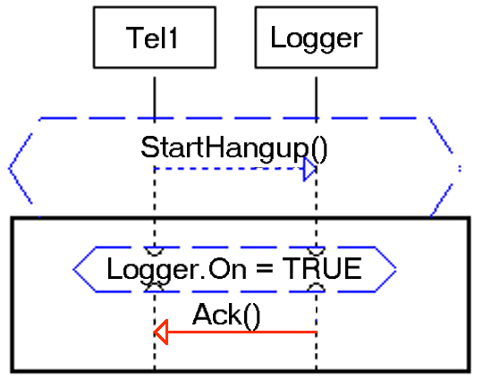
LSC Example – Cont
Blue = cold (may)

Slide 6
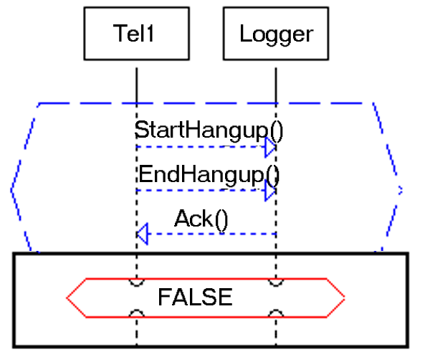
LSC Example – Cont – Anti-Scenario (Forbidden Scenario)

Slide 7
Play-Out (HM03)
Operational semantics for executing a specification (a set of LSCs)
Many LSCs coordinate in order to drive the system’s execution
Similar messages are unified
Hold current cut, and choose an enabled event from it
[D. Harel and R. Marelly, ``Specifying and Executing Behavioral Requirements: The Play-In/Play-Out Approach'‘, 2003]

Slide 8
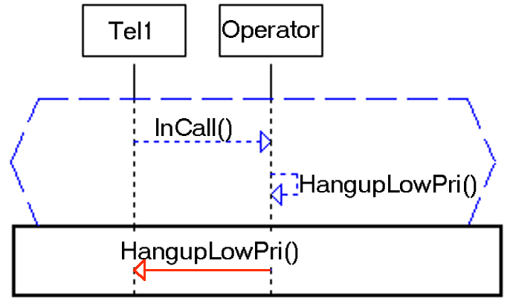
Play-Out - Example

Slide 9
Play-Out - Example

Slide 10
Play-Out - Example

Slide 11
Smart Play-Out - Motivation
Naïve play-out is not enough:
Conclusion:
Think before you act !

Slide 12
Smart Play-Out (HKMP02)
Definition: Given an initial configuration, a superstep is a sequence of events executed by the system, which satisfies all LSC requirements
A run is viewed as a series of external (environment) events, each followed by a superstep
[D. Harel, H. Kugler, R. Marelly and A. Pnueli, ``Smart Play-Out of Behavioral Requirements'‘, 2002]

Slide 13
Smart Play-Out – Cont
Specification +
Current Configuration
SPO Solver
No superstep exists
Superstep

Slide 14
SPO Implementations
To date, there are two implementations:
Model-checking based (HKMP02)
AI planning based (HS07)
We refer to the general problem of finding a superstep as the smart play-out problem
[D. Harel, H. Kugler, R. Marelly and A. Pnueli, ``Smart Play-Out of Behavioral Requirements'‘, 2002]
[D. Harel and I. Segall, "Planned and Traversable Play-Out: A Flexible Method for Executing
Scenario-Based Programs“, 2007]

Slide 15
Accelerating Smart Play-Out
(Unfortunate) Fact: Finding a superstep is PSPACE-hard (HKMS09)
Goal: Reduce the size of the specification before searching for a superstep
Agnostic to the specific implementation
Model checking based
AI planning based
…
[D. Harel, H. Kugler, S. Maoz and I. Segall, "How Hard is Smart Play-Out?
On the Complexity of Verification-Driven Execution” , 2009]

Slide 16
Accelerating Smart Play-Out
Specification M +
Current Configuration
Specification M’ + Current Configuration
SPO Solver
No superstep exists
Superstep
Superstep for M’
Superstep for M

Slide 17
The Transformation - Requirements
Given a spec M, find a new spec M’ s.t.:
Exists superstep S for M iff exists superstep S’ for M’
Given superstep S’ for M’, can be easily transformed into superstep S for M
|M’| < |M|

Slide 18
Why Work at the Level of Specification?
LSCs often have redundancies
Can be removed
Intentional under-specification
Can be left for naïve execution
Supersteps are typically short and local
Specification is succinct

Slide 19
The Algorithm – Outline
Step 1. Activation Closure
Step 2. Early Evaluation
Step 3. Unreachable Elimination
No
Fix Point ?
Yes
Step 4. Construct Elimination

Slide 20
The Example
Specification: LSCs as before x 3
Initial configuration:
Phone 1 – in a low priority call
Phone 2 – in a high priority call
Phone 3 – not in a call
Operator decides to hang up low priority calls (i.e., sends itself HangupLowPri)

Slide 21
The Example – The Initial Configuration
2
Tel1.LowPri = TRUE
Tel2.LowPri = FALSE

Slide 22
Step 1. Activation Closure
Goal: Remove LSCs that cannot be activated in this superstep

Slide 23
Step 1. Activation Closure
This chart is not active
(At least) one of its prechart messages does not appear in any main chart
Conclusion:
This chart will not be activated in this superstep
➔ May be completely removed
Initial Configuration:
2
Consider the LSC:
3

Slide 24
Step 1. Activation Closure
This chart is not active
(At least) one of its prechart messages does not appear in any main chart (even though it used to…)
Conclusion:
This chart will not be activated in this superstep
➔ May be completely removed
Now consider this LSC:
3
3

Slide 25
Step 2. Early Evaluation
Goal: Pre-evaluate conditions and assignments whenever possible (similar to constant propagation in code)

Slide 26
Step 2. Early Evaluation
2
TRUE
2
FALSE

Slide 27
Step 3. Unreachable Elimination
Goal: Remove unreachable constructs

Slide 28
Step 3. Unreachable Elimination
2
TRUE
2
FALSE

Slide 29
And Repeat Iteratively…
This chart is not active
(At least) one of its prechart messages does not appear in any main chart (even though it used to…)
Conclusion:
This chart will not be activated in this superstep
➔ May be completely removed
2

Slide 30
(After Reaching a Fixpoint) – Step 4. Construct Elimination
The first three steps removed constructs that cannot participate in the superstep
Construct Elimination removes constructs that may participate in the superstep, but their timing is unimportant

Slide 31
Step 4. Construct Elimination
Appears in a single main chart
Does not modify any object state (/ property)
Conclusion:
No smartness needed here
➔ May be completely removed

Slide 32
Accelerating Smart Play-Out
Specification M +
Current Configuration
Specification M’ + Current Configuration
SPO Solver
No superstep exists
Superstep for M’
Superstep for M

Slide 33
Superstep Reconstruction
Given a superstep S’ for specification M’, construct a superstep S for M
Recall: First three steps removed constructs that cannot participate in the superstep ➔ Only the last one (Construct Elimination) affects the superstep correctness

Slide 34
Superstep Reconstruction
Construct Elimination removed constructs for which no smartness is needed
➔ Reconstruction: Execute eliminated constructs whenever enabled

Slide 35
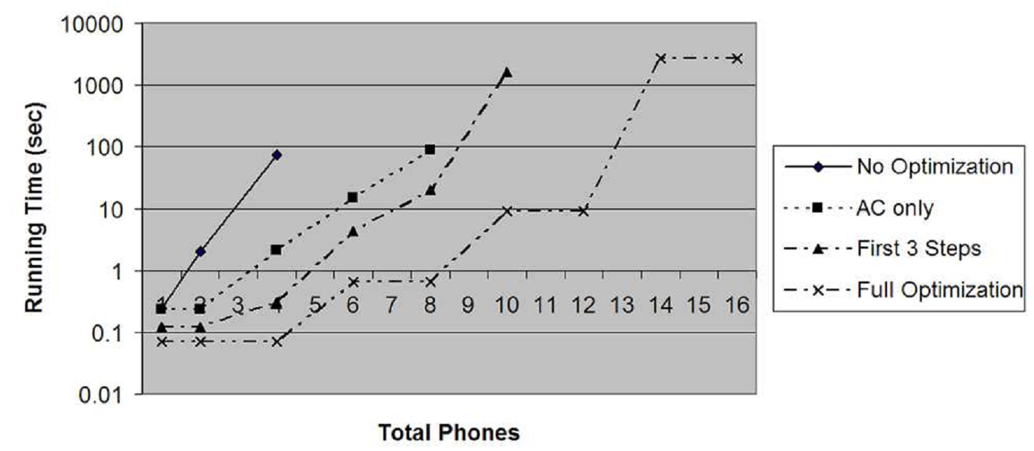
Experimental Results
Generalize the phone example, with n phones. ½ of them are in call, and ½ of those are low priority

Slide 36
Experimental Results 2
Consider a different initial configuration, in which the logger is off
The acceleration results in an empty specification (regardless of #phones)
➔ For this case, any supserstep is OK
➔ Can use naïve play-out
… and smart play-out computation time reduces to zero!

Slide 37
Future Work
Even better static analysis
Abstraction and approximation
Incremental superstep construction

Slide 38
Thank You !

