Slide 1
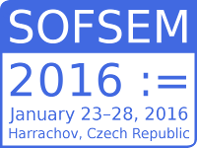
Utilizing vector models for automatic text lemmatization
Slovak University of Technology
Faculty of Informatics and Information Technologies
Ladislav Gallay
Supervisor: Ing. Marián Šimko, PhD.

Slide 2
Lemmatization
basic form of a word: houses > house, best > good
the basic task in natural language processing
understanding of text > sentence > word
unify different forms of the same word
similar to stemming
highly inflected languages are the most problematic
multiple lemmas based on context
axes -> axe or axis ?

Slide 3
Related work
dictionary approach
list of pairs: waiting – wait | waited – wait | houses - house
for Slovak: 2,5 million tokens, 77 000 unique words (Garabík, 2004)
rule-based approach
based on given set of rules: houses – house | waited - wait
Slovak language has many conditions and exceptions
cti – česť (honor)
combination – Tvaroslovník (Krajči, 2006)
based on the existing pairs new ones are created
find similar word based on the longest suffix
ponúk ponuka rúk ruka (offer, hand)

Slide 4
Vector models of words
captures relationships between words
semantic and grammatical relationships (Mikolov, 2013)
faster and more accurate training by utilizing neural networks
arithmetic operations
every word is represented by N-dimensional latent vector (N between 100-300)
word2vec tool by Google

Slide 5
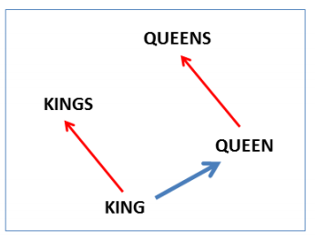
Vector models of words
vector(“king”) – vector(“man”) + vector(“woman”) = vector(“queen”)
man to woman is similar as king to queen
WOMAN
QUEEN
MAN
KING
KING
https://code.google.com/p/word2vec/

Slide 6
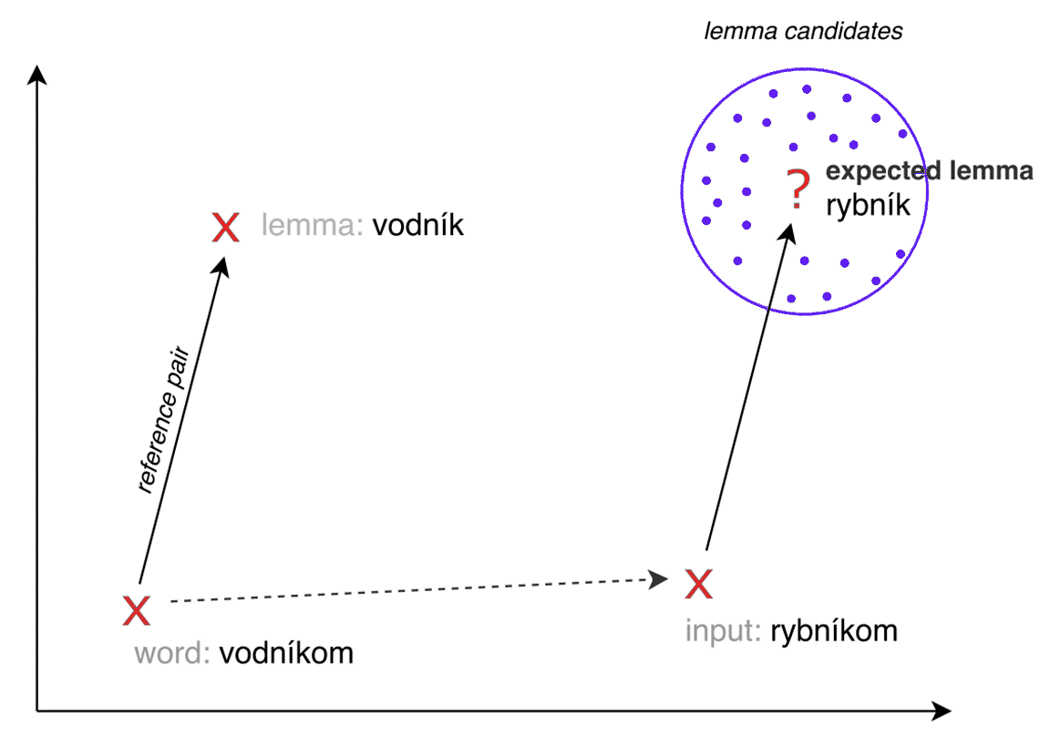
Our approach - idea
vodník – vodyanoy
vodníkom – with vodynaoy
rybník – pond / lake
rybníkom – with pond

Slide 7
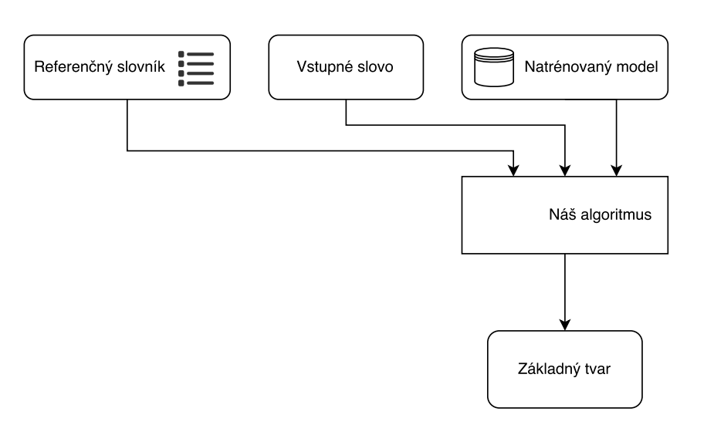
Lemmatization utilizing vector models
we need to know correct vector shift
we can observe similar known pairs and their vector shifts
auto-select several similar pairs from reference dictionary
for each pair and the input word calculate lemma candidates
choose the best candidate based on given weights
Reference pairs
Input word
Vector model
Algorithm
Lemma

Slide 8
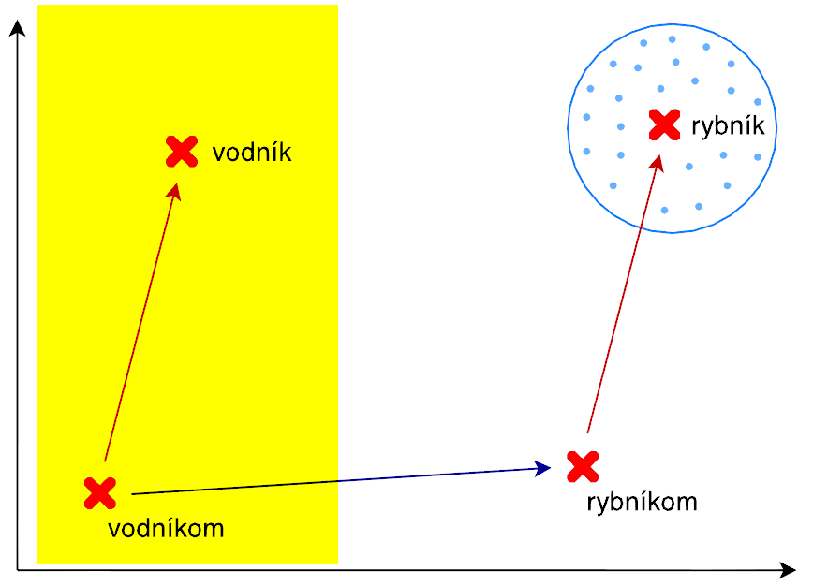
Relevant reference pairs selection
R1 – Suffix length
autom: putom, plotom, vlakom
R2 – Cosine similarity
semantically closest words
obtained from the vector model
autom: autobusom, šoférom, kolese
R3 – Grammatical categories
reference pairs are grouped into categories
for the input word we know which category to select from
e.g. Singular, Lokal case, gender “mesto”
autom: mestom, hniezdom, cestom

Slide 9
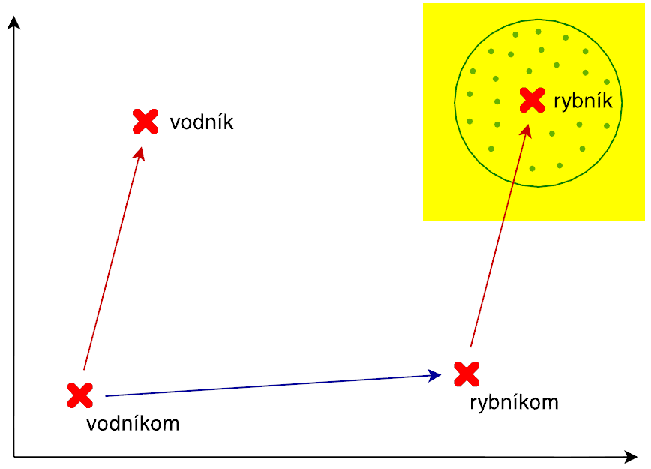
Lemma candidate weight computation
every candidate is given a weight based on the similarity with the input word
lemma is similar to the input word
for the input word autom (with car) it is obvious that slon (elephant) is not a correct lemma
DM0: Ignored (weight = 1)
DM1: Levenshtein distance
DM2: Jaro-Winkler distance
DM3: Relative prefix length

Slide 10
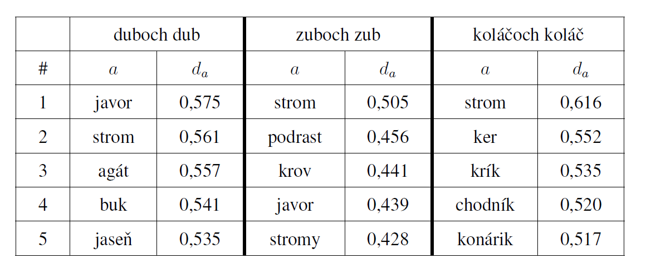
Input / Output example
Reference pairs SSip6 duboch dub
SSfs2 ženy žene
SSip6 zuboch zub
SSip6 koláčoch koláč
SSfp1 steny stena
…
Input word: stromoch (about trees)
Expected lemma: strom (tree)

Slide 11
Evaluation
latent vector model trained on Slovak National Corpus
655 572 511 words
reference pairs and input words extracted from the annotated lexicon by Ľudovít Štúr Institute of Linguistics (dictionary based approach)
nouns only
output is ordered list of candidates
the first one is expected lemma
results are evaluated as true or false

Slide 12
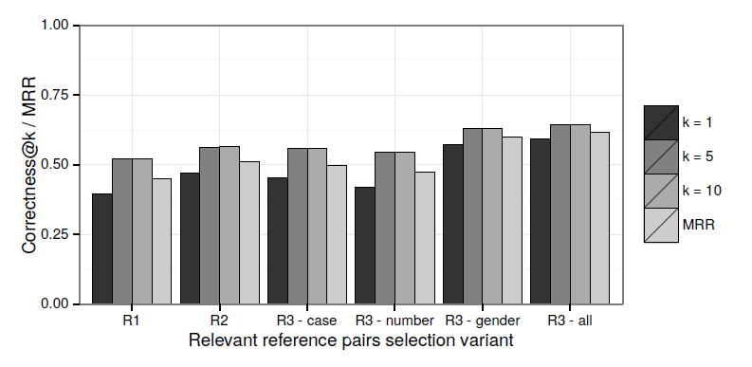
Evaluation – results (1)
comparison of reference pairs selection variants
random input words from corpus
R1 – suffix length
R2 – cosine similarity
R3 – grammatical categories
@k represents whether the correct lemma occurs in the top k positions

Slide 13
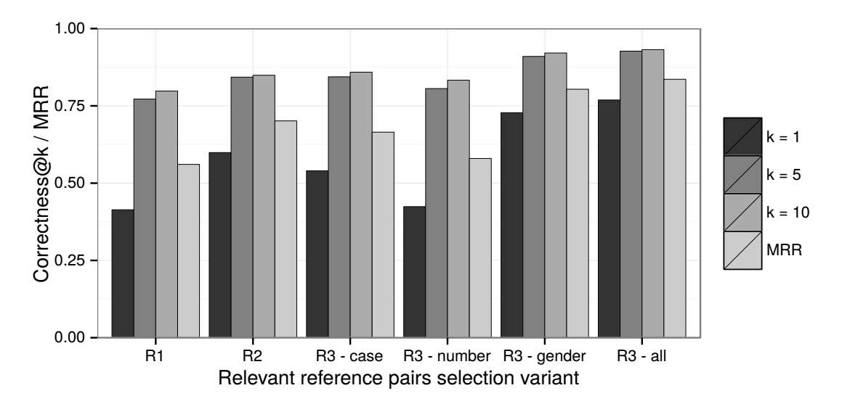
Evaluation – results (1)
comparison of reference pairs selection variants
the most frequent words from corpus
R1 – suffix length
R2 – cosine similarity
R3 – grammatical categories
@k represents whether the correct lemma occurs in the top k positions

Slide 14
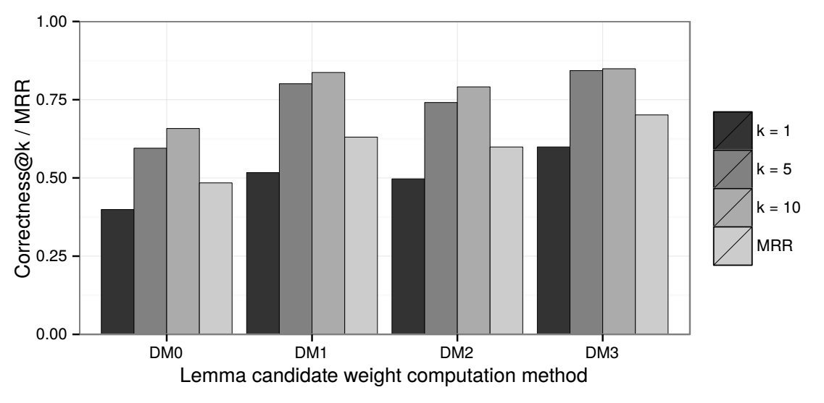
Evaluation – results (2)
comparison of weight computation methods
DM0 - Ignored (weight = 1)
DM1 - Levenshtein distance
DM2 - Jaro-Winkler distance
DM3 - Relative prefix length

Slide 15
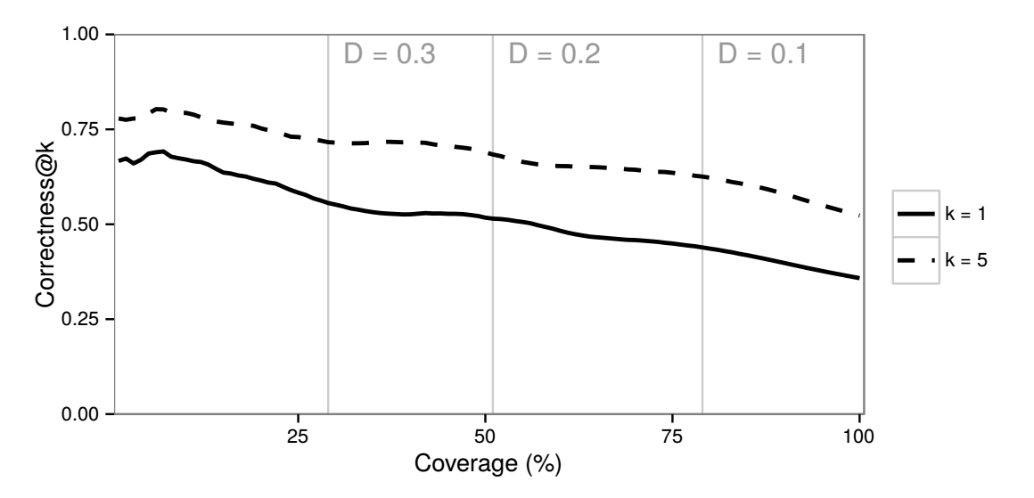
Evaluation – results (3)
correlation between correctness and coverage
searching for the threshold D

Slide 16
Conclusion
vector models are promising for automatic lemmatization
minimal human input
language independent
viable for languages with small knowledge base
strong dependency on corpus used for training
further work
evaluation on other parts of speech (beside nouns)
other variants for reference pair selection
lemma candidates weighting utilizing morphological or language-specific regularities
lemmatization including context

